Slide 1
Welcome to CS 211

Slide 2
Course Websites
Canvas (now at canvas.Humboldt.edu) is the central hub for the course
Github (https://github.com/acarteas/Teaching-DataStructures/tree/2018-Spring) will be used to store all course materials: course syllabus, official calendar, assignment descriptions, and other course documents
Gradescope (link on Canvas) will be used for labs and some programming assignments

Slide 3
The required textbook is free!
Data Structures and Algorithm Analysis v3.2 by Clifford Shaffer
Find the book on course Github
Also available from the author at https://people.cs.vt.edu/shaffer/Book/C++3elatest.pdf

Slide 4

Other Recommended Reading

Slide 5
I will be periodically asking clicker questions in the course (including today!)
Be sure that you have a turning point subscription.

Slide 6
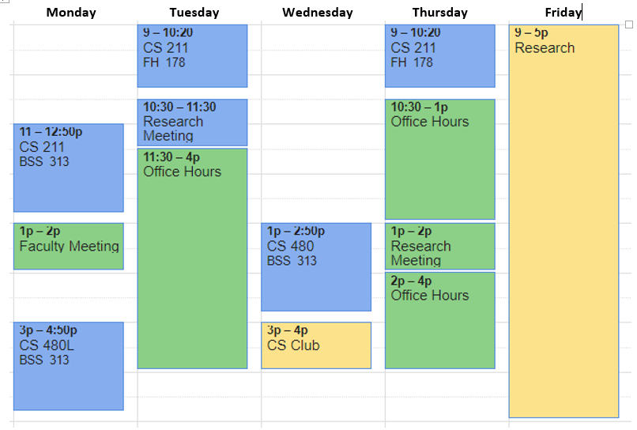
Adam’s Schedule

Slide 7
Grading
I’m continuing my “progressive” grading scheme from last semester
Idea: I care more about what you know at the end of the semester than what you know at the beginning of the semester
Possible solution: Through permissive grading, make it easier to get good grades at the beginning of the semester
Example: In order to get an A on PA1, you only need to get 70 out of 100 points possible.
On the final PA, you will actually need to earn 90+ points to get an A
Notes:
My hope is that this system will also allow me to push you while simultaneously allowing you to fail gracefully.

Slide 8
Programming Environments
I encourage you to use an IDE when working on your solutions. In class, I will be using the Clang C++ compiler. It is much more cross platform than G++. Therefore feel free to use any IDE that supports Clang (All lab computer should have this installed).
My preference for IDEs are:
Visual Studio 2017 with Clang support (requires extra plugin)
JetBrains CLion
Netbeans 8.1
CodeBlocks

Slide 9
Homework Policy
All homework must be submitted by the due date; NO LATE TURN-INS!

Slide 10
A Note on Cheating
Don't do it!
See syllabus for examples of cheating.

Slide 11
Grade breakdown
Participation (5%)
Programming assignments, homework, and micro assignments (40%)
Labs (10%)
Two midterm exams (10% / ea)
Final exam (25%)

Slide 12
Final grade translations
93.00 – 100.00 | A | 71.00 – 75.99 | C
90.00 – 92.99 | A- | 69.00 – 70.99 | C-
87.00 – 89.99 | B+
82.00 – 86.99 | B | 60.00 – 68.99 | D
78.00 – 81.99 | B- | 00.00 – 59.99 | F
76.00 – 77.99 | C+

Slide 13
What to expect in my course: A review from a prior student
On the rare occasion when the course material presented in class was actually relevant to the course assignments we were given. Most of the time there was not at all enough relevant instruction in class for the assignments given that were worth a large part of our grade. I found myself always needing to use outside resources to learn the material in order to complete assignments, because the relevant instructional material just did not exist as part of class instruction…
…It is insanely unreasonable for a professor to expect students to spend 20 or sometimes more hours per week using outside resources trying to understand what the professor's starter code does, what needs to be done to complete the assignment, how the data structures necessary work in c++, and then how to use the data structure to solve the problem. It was not at all unusual for this to take me and many other people in the class who I spoke to up to or more than 20 hours per week…
…I do not pay thousands of dollars per semester for my education just to have to spend basically the equivalent of a part time job Googling my education on top of that because I'm not getting the information I need to complete the course assignments from my professor's instruction.

Slide 14
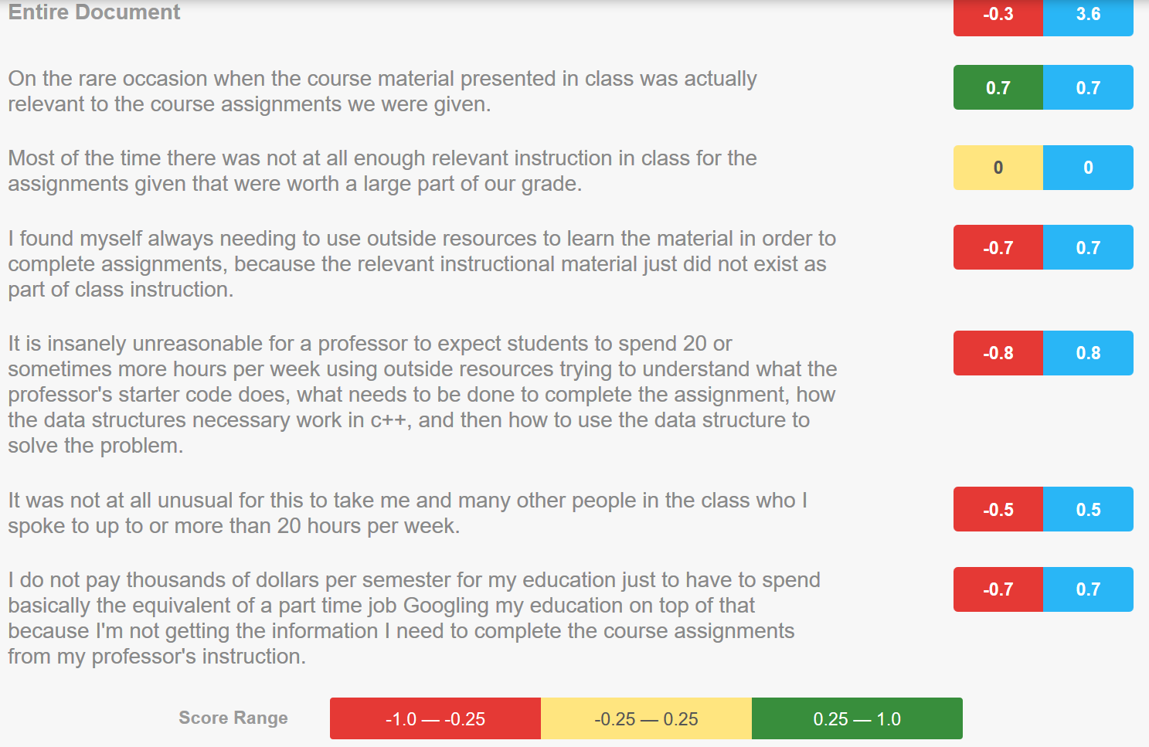

Slide 15
A more fun comment
Some days Adam will seem like he's in a great mood and his lectures will get like 5x better. not a complaint, we can't all be happy-go-lucky all the time, but just something i noticed.

